Slide 1


Slide 2

Standard set of tag libraries
Encapsulates core functionality common to
many JSP applications
  iteration and conditionals
  XML
  database access
  internationalized formatting
Likely to evolve to add more commonly
used tags in future versions

Slide 3

You don't have to write them yourself
You learn and use a single standard set of
tag libraries that are already provided by
compliant Java EE platforms
Vendors are likely to provide more
optimized implementation

Slide 4

JSTL is not part of the JSP 1.2 Specification
It is a separate specification that requires a separate download
Available only in servers that support servlets 2.3 and JSP 1.2 or later. Cannot be retrofitted into JSP 1.1.
The JSTL expression language will be part of JSP 2.0

Slide 5

Core (prefix: c)
– Variable support, Flow control, URL management
XML (prefix: x)
– Core, Flow control, Transformation
Internationalization (i18n) (prefix: fmt)
– Locale, Message formatting, Number and date Formatting
Database (prefix: sql)
– SQL query and update
Functions (prefix: fn)
– Collection length, String manipulation

Slide 6

Core
– <%@ taglib prefix="c" uri="http://java.sun.com/jsp/jstl/core" %>
XML
– <%@ taglib prefix="x" uri="http://java.sun.com/jsp/jstl/xml" %>
Internationalization (i18n)
– <%@ taglib prefix="fmt" uri="http://java.sun.com/jsp/jstl/fmt" %>
Database (SQL)
– <%@ taglib prefix="sql" uri="http://java.sun.com/jsp/jstl/sql" %>
Functions
– <%@ taglib prefix="fn" Uri = "http://java.sun.com/jsp/jstl/functions" %>

Slide 7

Evaluates an expression and outputs the result of the evaluation to the current JspWriter object
Syntax
<c:out value="value” [default="defaultValue"] />
<c:out value=“Hello world”>
<c:out value=“${4+10}”>
<c:out value=“${V1}”>

Slide 8

Sets the value of an EL variable or the
property of an EL variable via “var” attribute
– in any of the JSP scopes via “scope” attribute
– page, request, session, application
If the variable does not already exist, it gets
created and saved (in the scope object)
Variable can be set in 2 different ways
– <c:set var="foo" scope="session" value="..."/>
example:
-<c:set var="bookId“ value= "${param.BookID}“ />
– <c:set var="foo">value to be set</c:set>

Slide 9

<c:set var=“loop" scope="page">
<c:forEach var="i" begin="1" end="10">
<c:out value="HI"/>
</c:forEach>
</c:set>
Set variable Loop <hr>
<c:out value="${loop}"/>
Remove an EL variable
– <c:remove var="cart" scope="session"/>

Slide 10

Use for iteration & lopping
Allows you to iterate over a collection of objects
– items: represent the collection of objects
– var: current item
– varStatus: iteration status
– begin, end, step: range and interval
Collection types
– java.util.Collection
– java.util.Map

Slide 11

<UL>
<c:forEach var="i" begin="1" end="10">
<LI><c:out value="${i}"/>
</c:forEach>
</UL>
<c:forEach var="string" items="${stringArray}">
<c:out value="${string}"/><br>
</c:forEach>
<c:forEach var="token" items="bleu,blanc,rouge">
<c:out value="${token}"/><br>
</c:forEach>

Slide 12
<UL>
<c:forEach
var="seconds"
begin="0"
end="${pageContext.session.maxInactiveInterval}"
step="100">
<LI><c:out value="${seconds}"/> seconds.
</c:forEach>
<LI>Timeout exceeded.
</UL>

Slide 13

<c:forTokens var="token" items="one,two,three" delims=",">
<c:out value="${token}"/>
</c:forTokens>

Slide 14

One choice: if
<c:if test="${someTest}">
Content
</c:if>
Lots of choices: choose
<c:choose>
<c:when test="test1">Content1</c:when>
<c:when test="test2">Content2</c:when>
...
<c:when test="testN">ContentN</c:when>
<c:otherwise>Default Content</c:otherwise>
</c:choose>

Slide 15

<UL>
<c:forEach var="i" begin="1" end="10">
<LI><c:out value="${i}"/>
<c:if test="${i > 7}">
(greater than 7)
</c:if>
</c:forEach>
</UL>

Slide 16

<UL>
<c:forEach var="i" begin="1" end="10">
<LI><c:out value="${i}"/>
<c:choose>
<c:when test="${i < 4}">
(small)
</c:when>
<c:when test="${i < 8}">
(medium)
</c:when>
<c:otherwise>
(large)
</c:otherwise>
</c:choose>
</c:forEach>
</UL>

Slide 17

More generic way to access URL-based resources
Absolute URL: for accessing resources outside of Web application
Relative URL: for accessing resources inside of
the same Web application
Read content from arbitrary URLs
• Insert into page
• Store in variable
<c:param> tag can be used to specify
parameters

Slide 18
<c:import url="header.jsp">
<c:param name="pageTitle" value="newInstance.com"/>
<c:param name="pageSlogan" value=" " />
</c:import>

Slide 19

Sends an HTTP redirect to the client
Takes <c:param> sub tags for including
parameters in the returned URL

Slide 20

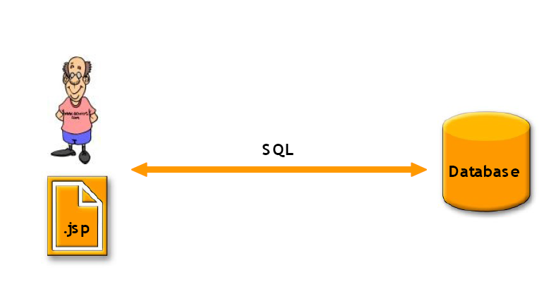
Simple Apps

Slide 21

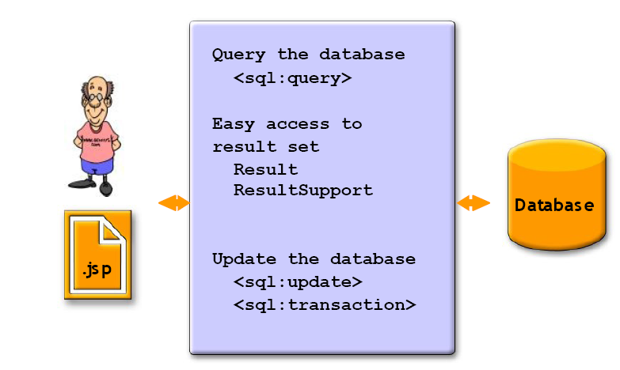

Slide 22

<sql:setDataSource>
– Specifies data source (can also be set by config settings)
<sql:query>
– Queries database and stores ResultSet in variable
– Warning: this usage violates rule of keeping business
logic out of presentation layer. Instead, do database
access in servlet and pass results to JSP via MVC.
<sql:update>
<sql:param>
<sql:dateParam>
<sql:transaction>
– Performs the enclosed <sql:query> and <sql:update>
actions as a single transaction

Slide 23
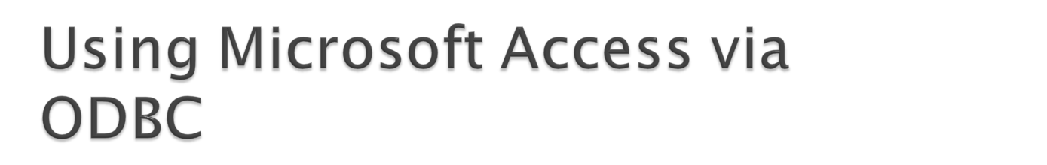
Driver
– sun.jdbc.odbc.JdbcOdbcDriver
Comes bundled with JDK
URL
– jdbc:odbc:Northwind
Username
– Empty string
Password
– Empty string

Slide 24

<sql:setDataSource
driver="sun.jdbc.odbc.JdbcOdbcDriver"
url="jdbc:odbc:Northwind"
user=""
password=""/>

Slide 25

Form 1: use the sql attribute
<sql:query var="results" sql="SELECT * FROM …"/>
Form 2: put the query in the body of the tag
<sql:query var="results">
SELECT * FROM …
</sql:query>
Options
– dataSource
– maxRows
– startRow
Caution
– Embedding SQL directly in JSP may be hard to maintain.

Slide 26

<%@ taglib prefix="c"
uri="http://java.sun.com/jsp/jstl/core" %>
<%@ taglib prefix="sql"
uri="http://java.sun.com/jsp/jstl/sql" %>
<sql:setDataSource
driver="sun.jdbc.odbc.JdbcOdbcDriver"
url="jdbc:odbc:Northwind"
user=""
password=""/>

Slide 27

<sql:query var="employees">
SELECT * FROM employees
</sql:query>
<UL>
<c:forEach var="row" items="${employees.rows}">
<LI><c:out value="${row.firstname}"/>
<c:out value="${row.lastname}"/>
</c:forEach>
</UL>

Slide 28

To create a custom tag library following files should be written
Tag Handler class file (Java source file)
Tag descriptor file ( XML file)
Execute tag handler class
JSP Page
Custom Tag used Here
Tag Descriptor file
Through uri, tagdir
Find location of tag
handler class

Slide 29

The classic tag handler API contains three primary interfaces, all are part of the javax.servlet.jsp.tagext package: Tag, IterationTag, and BodyTag.
The Tag interface defines the methods you need to implement for any tag handler.
The IterationTag interface extends the Tag interface and adds methods needed for iteration over the action element's body
The BodyTag interface extends the IterationTag interface and adds methods that provide access to the action element's body evaluation result.

Slide 30

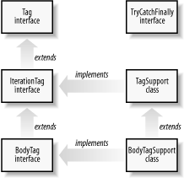
To make it easier to develop a classic tag handler, two support classes are defined by the API: TagSupport and BodyTagSupport

Slide 31
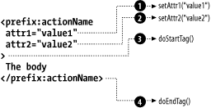
The Tag interface has two: doStartTag( ) and doEndTag( )
The container calls these methods when the start tag and end tag are encountered
public int doStartTag( ) throws JspException { return SKIP_BODY; }
The method returns an int that must be one of two values defined by the Tag interface: SKIP_BODY or EVAL_BODY_INCLUDE.
public int doEndTag( ) throws JspException { return EVAL_PAGE; }
It can also return one of two int values defined by the Tag interface EVAL_PAGE, SKIP_PAGE

Slide 32
Tag handler class:-
package mypack;
import java.io.*;
import javax.servlet.jsp.*;
import javax.servlet.jsp.tagext.*;
public class ClassicTagDemo extends TagSupport {
public int doStartTag(){
try{
JspWriter out = pageContext.getOut();
out.print("Hello World");
}catch(IOException ioe){}
return EVAL_BODY_INCLUDE;
}
}

Slide 33
Tag description file (.tld)
<?xml version="1.0" encoding="UTF-8"?>
<taglib version="2.0" xmlns="http://java.sun.com/xml/ns/j2ee" xmlns:xsi="http://www.w3.org/2001/XMLSchema-instance" xsi:schemaLocation="http://java.sun.com/xml/ns/j2ee web-jsptaglibrary_2_0.xsd">
<tlib-version>1.0</tlib-version>
<short-name>mytaglib</short-name>
<uri>/WEB-INF/classes/mypack/ClassicTagDemo</uri>
<info>An example classic tag library</info>
<tag>
<name>ClassicTagDemo</name>
<tagclass>mypack.ClassicTagDemo</tagclass>
<body-content>empty</body-content>
<info>Just Says Hello</info>
</tag>

Slide 34
Use of custom tag in JSP
<html>
<head>
<meta http-equiv="Content-Type" content="text/html; charset=UTF-8">
<title>JSP Page</title></head>
<body>
<h2>Hello World!</h2>
<%@ taglib prefix="h" uri="mytaglib"%>
<h:ClassicTagDemo/>
</body>
</html>

